Slide 1
Team 17
Sprint 1 Presentation

Slide 2
Presentation outline
Presentation will be around 15 minutes
15 minutes at the end for questions
Please feel free to stop me at anytime for clarification or other questions
Let me know if anything is hard to see over the screen share, we can always open up the relevant document to zoom in

Slide 3
Topics we will be covering
Intro to the team
Project outline
Current project backlog
Sprint 1 Summary + retrospective overview
Risk management plan
UI Prototype showcase
Architecture review + tech stack
Testing plan
Live demo
Sprint 2 plan
Questions?

Slide 4
Introduction to our team members

Slide 5
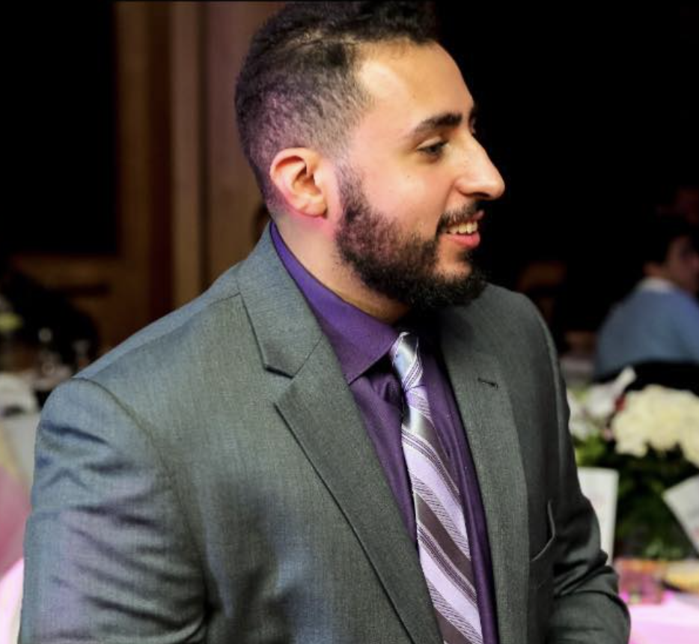
Andre Ibrahim
About me:
3rd year software engineering student
Previous work experience in desktop application development
My Hobbies:
All sports!! Basketball, Brazilian jiu jitsu, volleyball
My role in the team:
Backend and frontend development
Software design

Slide 6
Dan Raiu
About myself: Currently a 3rd year Software Engineering Student at Concordia
Interests: Gaming, Algorithms, Stocks
Role in the Project:
Front End Developer
Documentation

Slide 7
Daren Kafafian
About myself: Currently a 3rd year Software Engineering Student at Concordia
Interests: Gaming, Sports, F1
Role in the Project:
Front End Developer

Slide 8
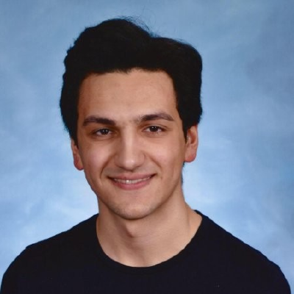
Domenic Seccareccia
About myself: Currently a 3rd year Software Engineering Student at
Concordia
Interests: Finance / Investing, Technology, Sports
Role in the Project:
UI/UX Designer
Front End Developer

Slide 9
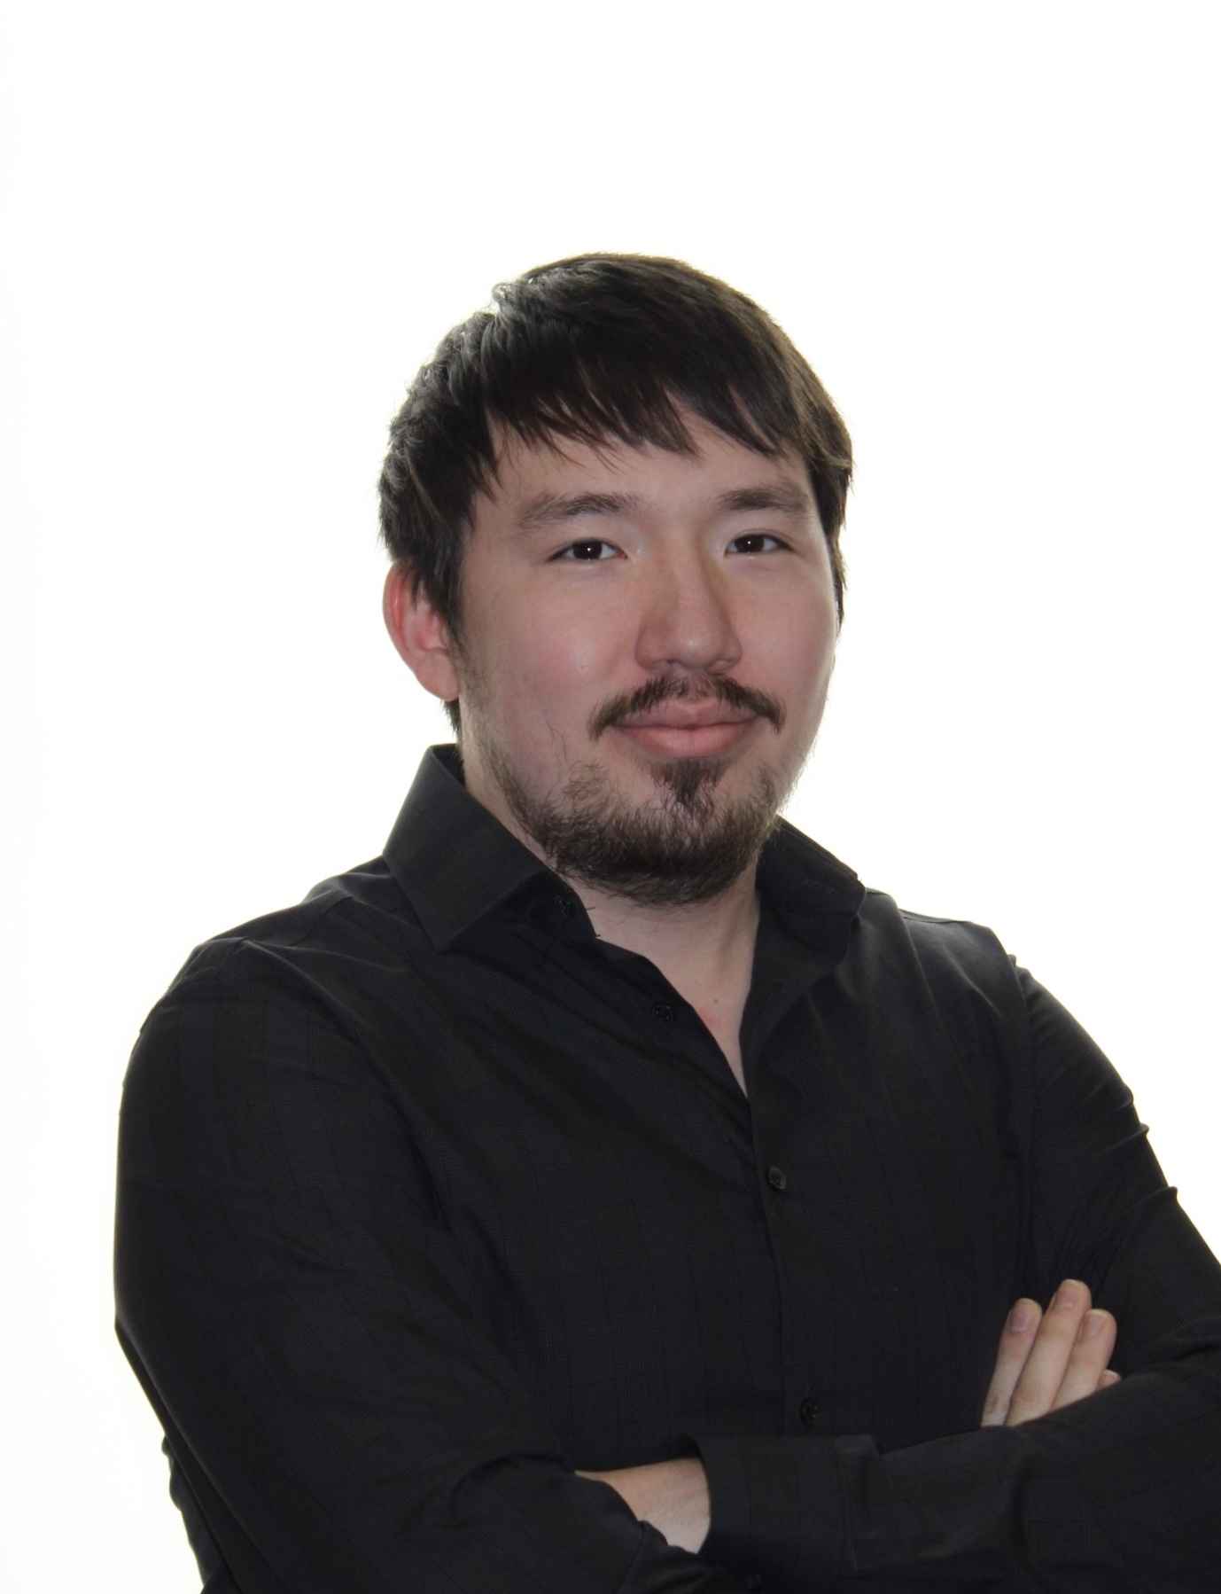
Ejazali Rezayi
About myself
Currently a 3rd year in software engineering
Interests
Gaming, anime, sports
Role in the Project
Front end and back end developer

Slide 10
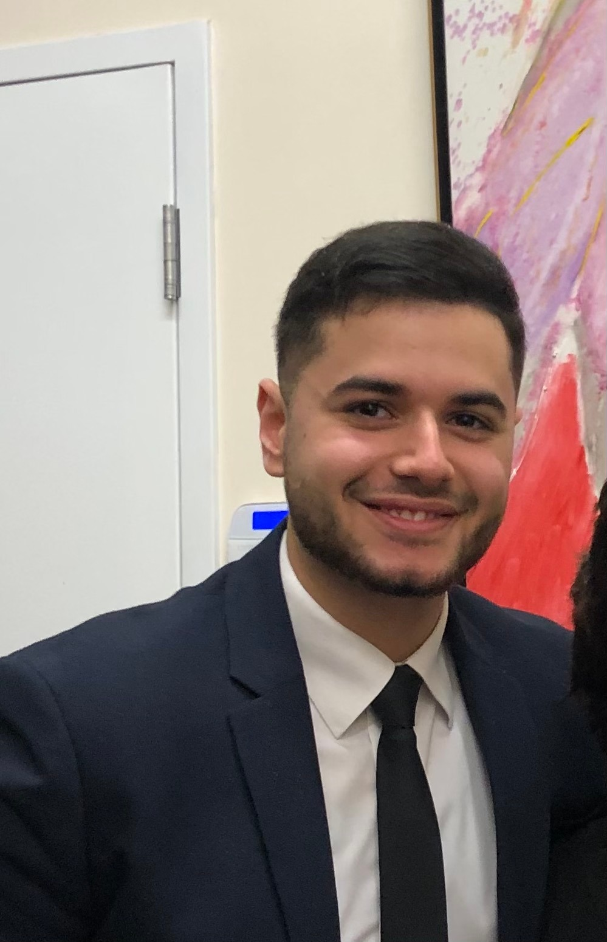
Khagik Chris Astor
About myself: Currently a 3rd year Software Engineering Student at
Concordia
Interests: Gaming, Fitness, Food
Role in the Project:
Front End Developer
UI/UX and Software design
Coordinator

Slide 11
Lucas Blanchard
About:
Software Engineering Student
Web Design / Development
Programmer
Role:
Frontend development

Slide 12
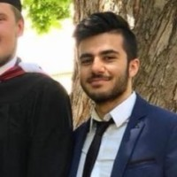
Rafi Stepanians
About myself: Currently a 3rd year Software Engineering Student at
Concordia
Interests: Gaming, Sports, Travelling
Role in the Project:
Front End Developer
Back End Developer

Slide 13
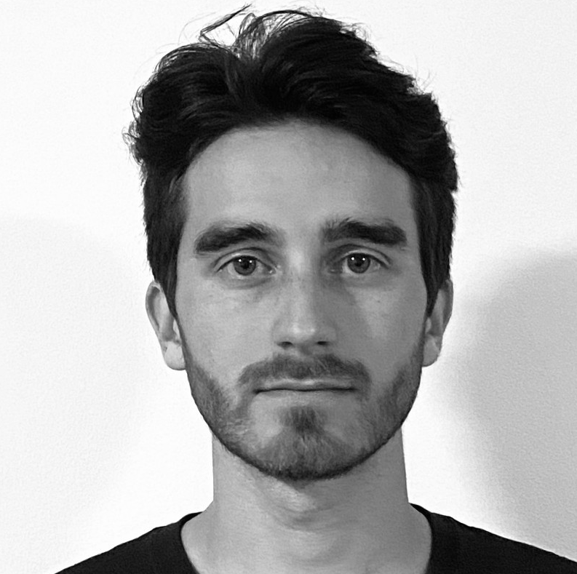
Jason Gerard
A little bit about myself: 3rd year software engineering student at Concordia
My interests: computers / technology, science fiction
My role in the project:
Product management
Software design and development
Devops

Slide 14
Project Outline

Slide 15

Our Application

Slide 16
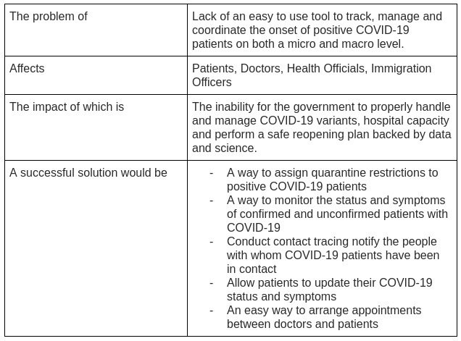
Our problem statement

Slide 17
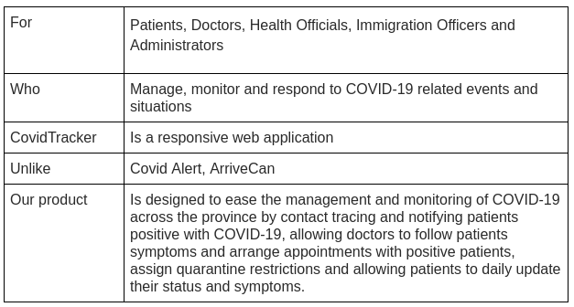
Product position statement

Slide 18
About our development lifecycle
Agile methodology
User story focused
No assigned work, the individual decides what they want to do
Peer programming
Design first
UI Prototypes + Architecture
Continuous integration
Will eventually also be continuous deployment

Slide 19
Our stakeholders
Users -> Patients, Doctors, Health Officials, Immigration Officers, Administrators
Product Owner(s)
Project Champion
Organization Management Team
Development Team
Analysts
Designers
Testers

Slide 20
Current project backlog

Slide 21
Project is broken down into epics
Patient Management
Status Management
Contact Tracing
Messaging system
Notification system
QR code system
Authentication and Authorization
Project Setup
Project Infrastructure
**View individual user stories from the backlog in the document submitted**

Slide 22
About our product management workflow
As the team finds time
We book refinement meetings to discuss and validate the user stories and tasks for the next sprint
Refinement includes
Validation of definition of done + requirements
User story points, risk, and priority
Every user story, task, or bug is part of an epic
User stories and tasks are broken down into sub-tasks so multiple developers can work on a single issue asynchronously

Slide 23
Sprint 1 Summary + retrospective overview

Slide 24
Our focus for sprint 1
Deliver 3 user stories from our authentication and authorization epic
Setting up project architecture and infrastructure
Build out backlog for upcoming sprints
Overall reached our commitment of 56 points and closed all issues in the sprint

Slide 25
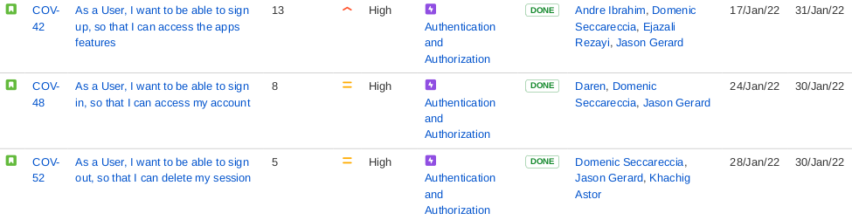
User stories completed

Slide 26
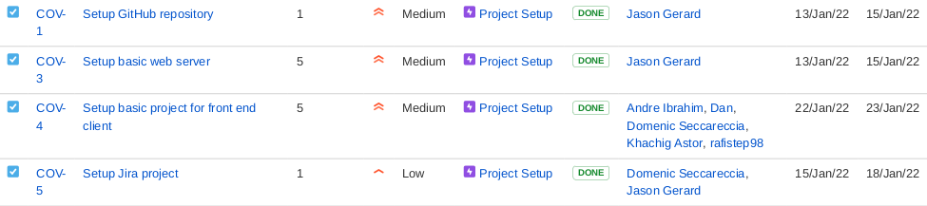
Tasks for architecture and infrastructure

Slide 27
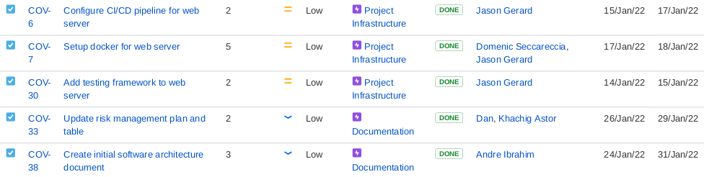
Tasks for architecture and infrastructure cont.

Slide 28
Tasks for architecture and infrastructure cont.

Slide 29
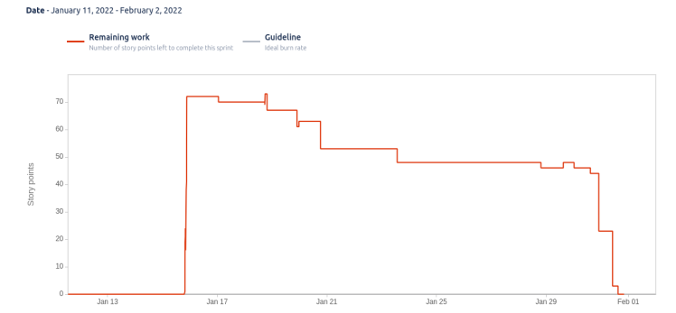
Burndown chart

Slide 30
Project velocity after sprint 1
Velocity = 56
This will increase in the following sprints because
We are setup to iterate faster now
All team members have a better idea of the scope of the project
Everyone has a better idea of their responsibilities in the project

Slide 31
Retrospective format
Our retro format is as follows
5 minutes to creates card in 2 columns, no discussion
Went Well
To Improve
After everyone is finished writing
Merge similar cards
Vote on the cards (each member has 4 votes)
Starting from the highest voted card we have a discussion about the topic
As we discuss we add cards to the Action Items section for specific actions one person or the entire team can start taking
We will follow up on action items during the next retrospective meeting

Slide 32
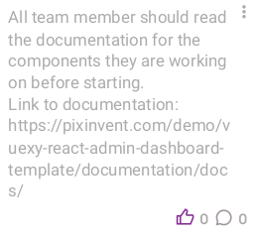
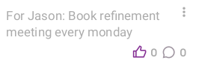
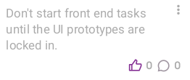
Our actions items

Slide 33
Risk management plan

Slide 34
Identified risks
We have identified 9 different risks this sprint, all are documented in the submission.
I will only discuss the risks we resolved this sprint as those are the ones that affected us.

Slide 35
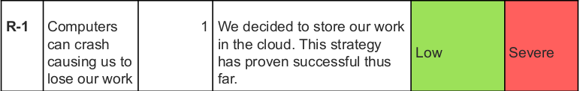
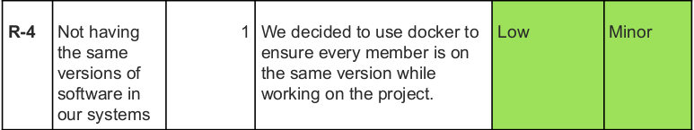
Risks resolved in sprint 1

Slide 36
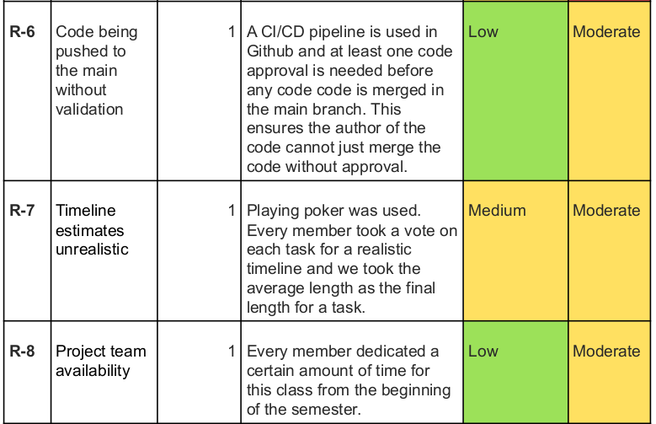
Risks resolved in sprint 1 cont.

Slide 37
UI Prototype showcase

Slide 38
First let’s go over our persona types which drive the UI/UX
Patient
Doctor
Health Official
Immigration Officer
Administrator

Slide 39
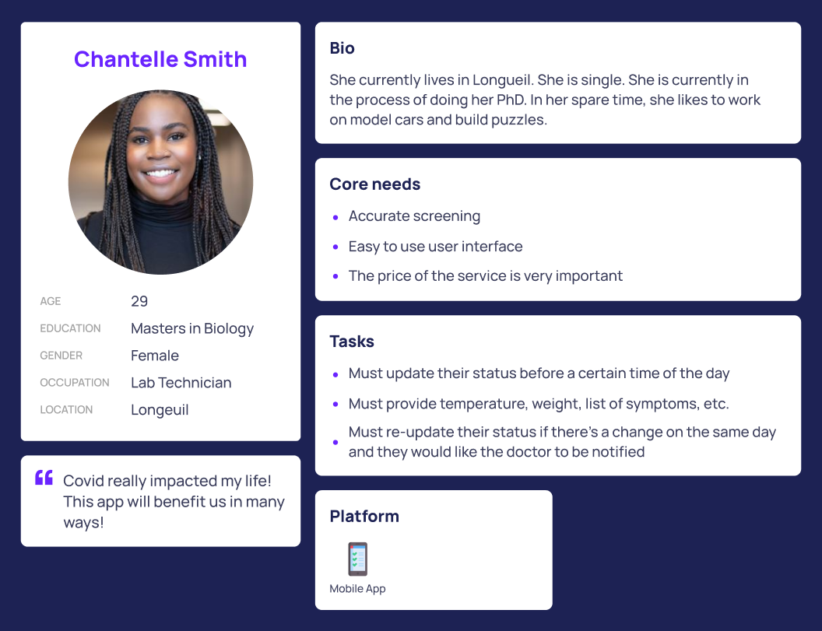
Patient
Persona

Slide 40
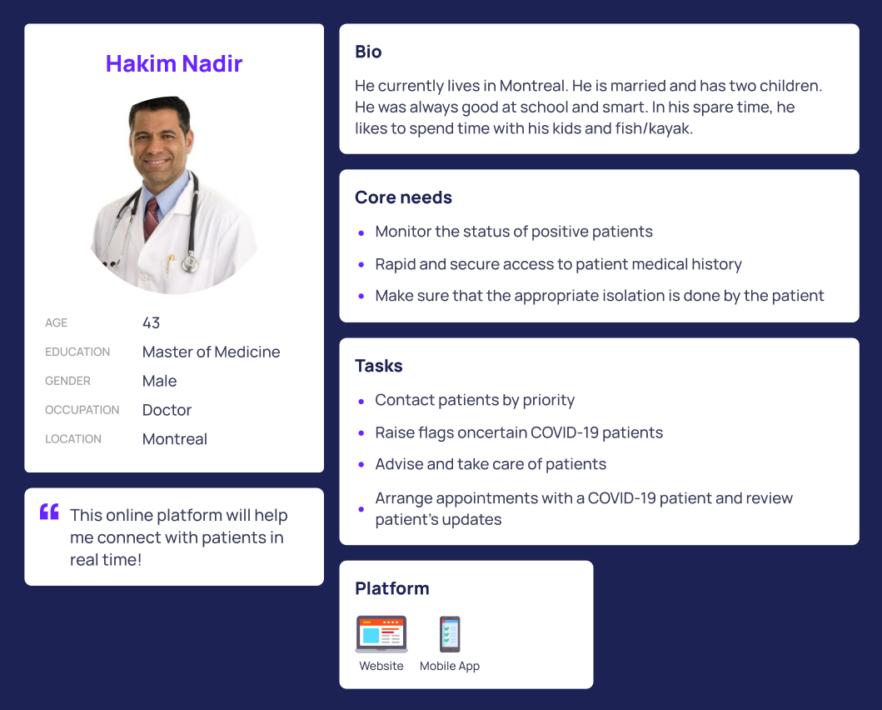
Doctor
Persona

Slide 41
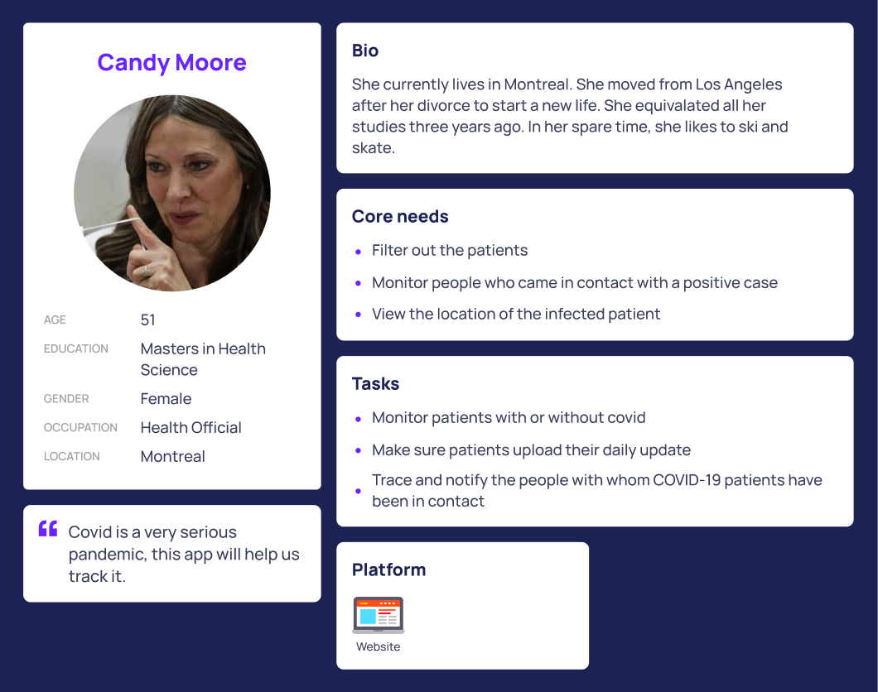
Health Official
Persona

Slide 42
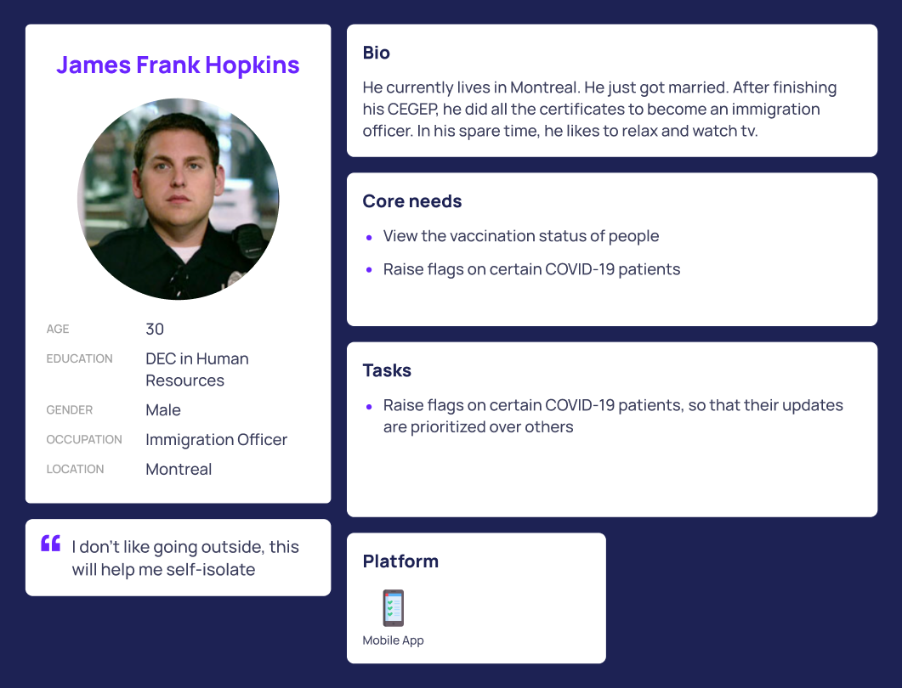
Immigration
Officer
Persona

Slide 43
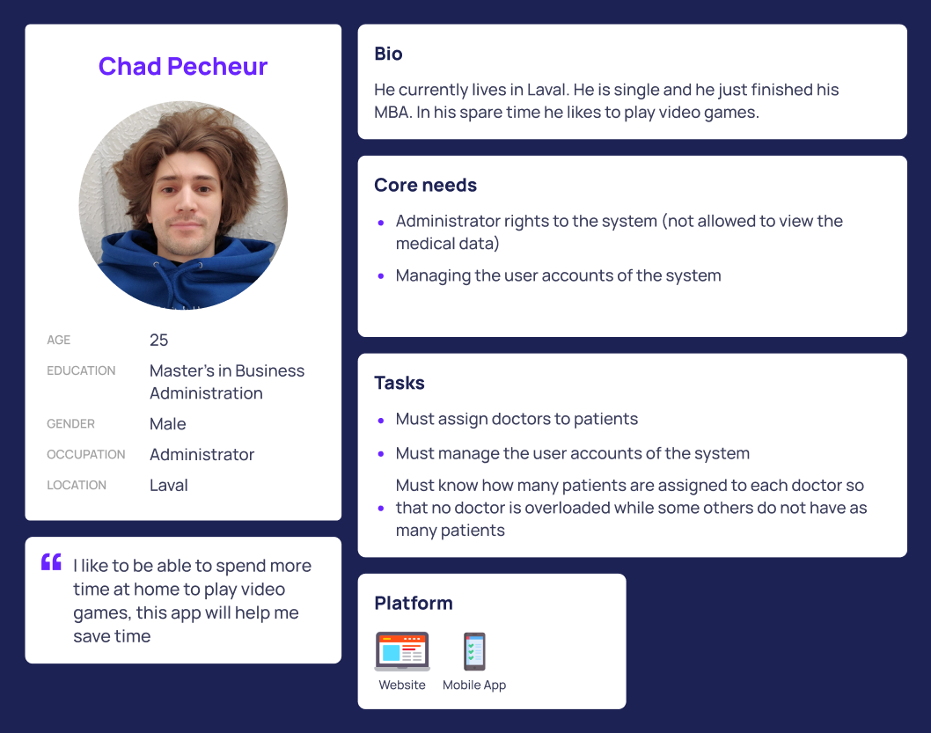
Admin
Persona

Slide 44
Let's go into Figma and see the UI mockups and interactive prototypes

Slide 45
Architecture review + tech stack

Slide 46
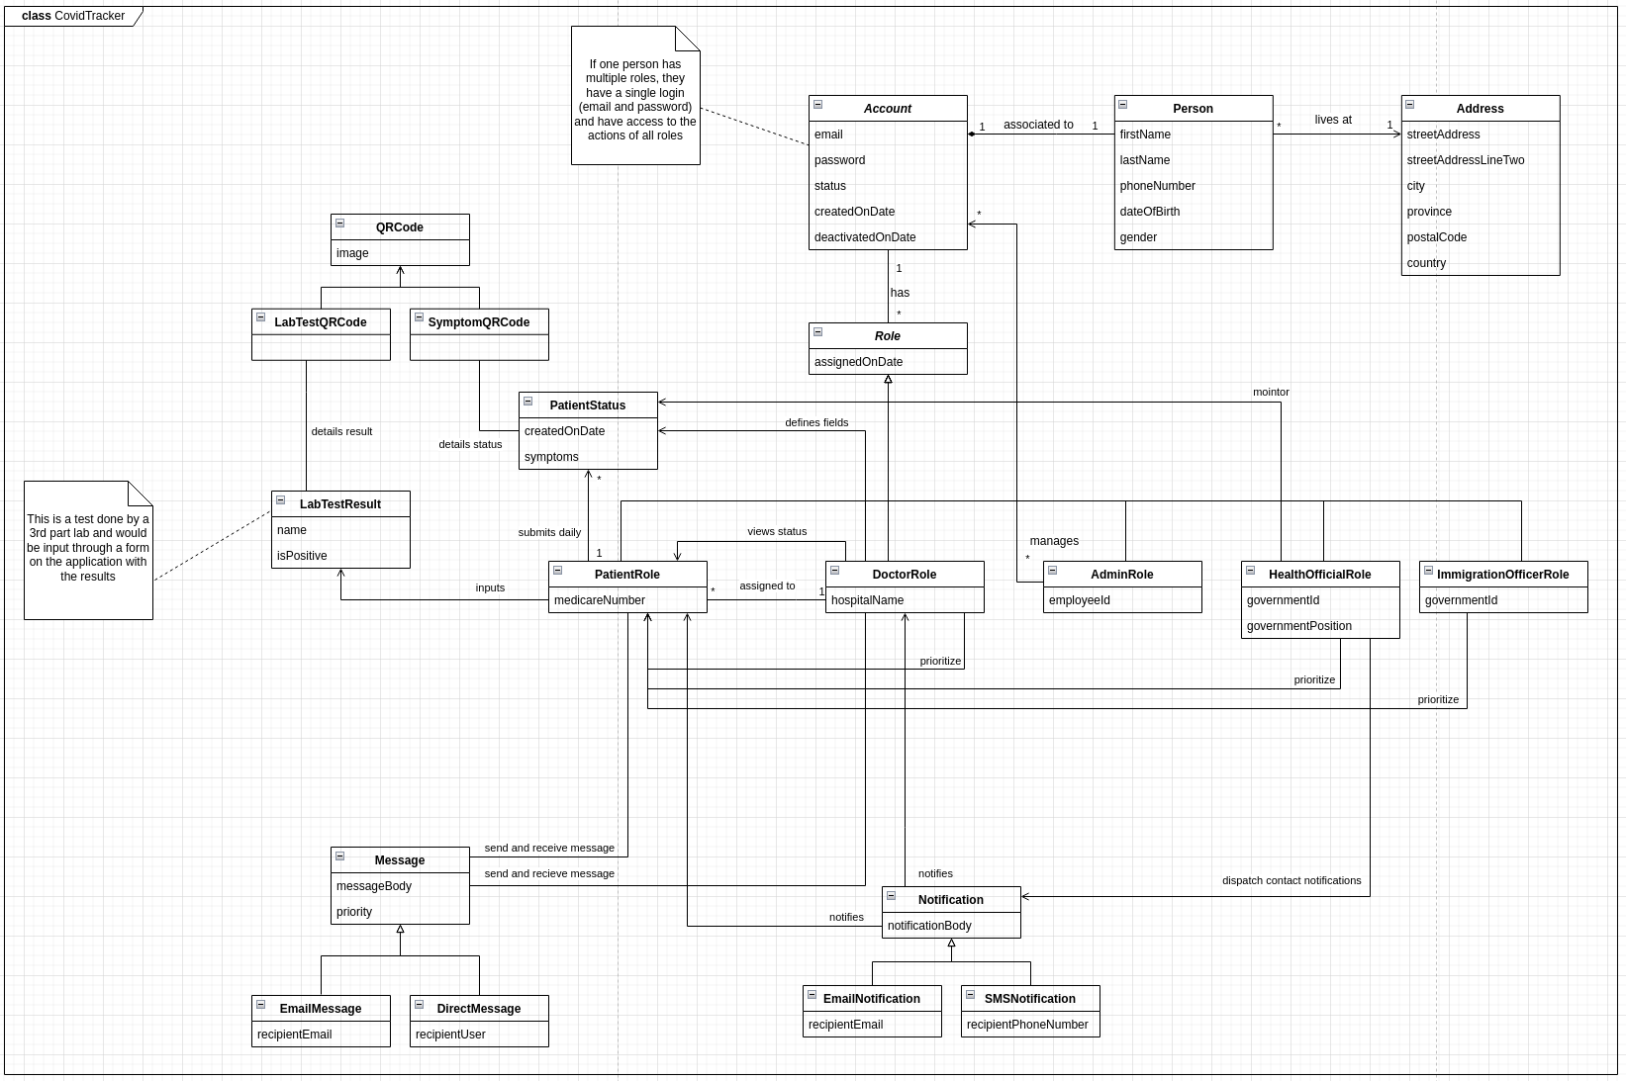

Slide 47
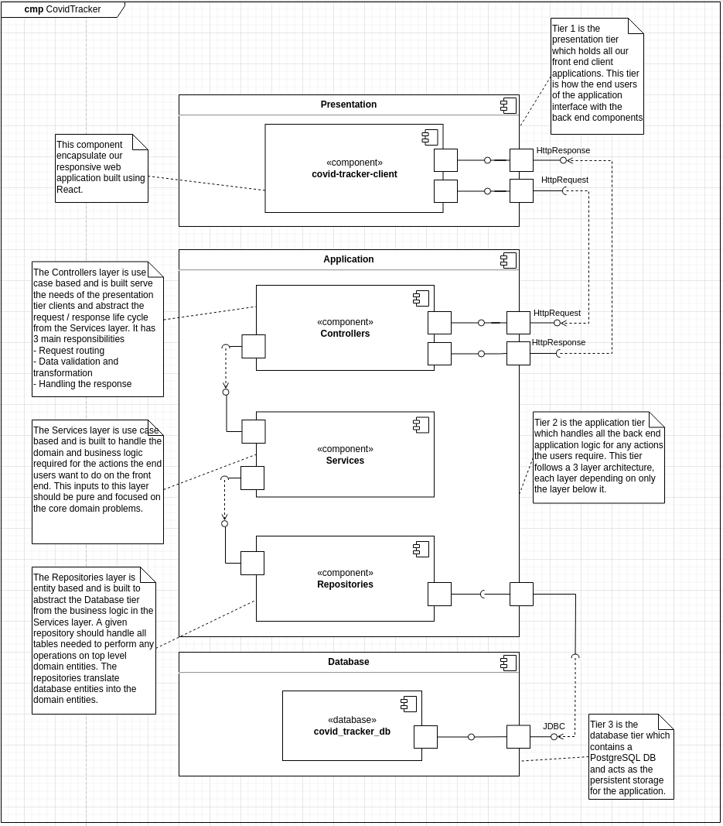

Slide 48
Tech stack - Presentation Tier
The presentation tier is composed of a thin single page application (SPA) client
Language -> JavaScript
Core framework -> React
Styling -> SCSS
Core external library -> Vuexy (template library)
***A full comparison for all languages and frameworks in in the document**

Slide 49
Tech stack - Application Tier
The application tier is composed of a monolithic web service
Language -> Typescript
Web framework -> Restify
Dependency injection -> Inversify
Database client -> pg
***A full comparison for all languages and frameworks is in the document**

Slide 50
Tech stack - Database Tier
The database tier is composed of a single PostgreSQL instance
***A full comparison for all languages and frameworks is in the document**

Slide 51
Everything is on Docker
We use docker containers to develop the application, test, and build for production
Dockerfiles are built using multi staged builds so they can be built for development or production
We use docker-compose in our development environments in order to orchestrate all required containers for build, run, log, and teardown actions

Slide 52
CI/CD pipeline using GitHub Actions
We have a CI pipeline setup right now which will evolve into a CI/CD pipeline
Where CI = continuous integration and CD = continuous deployment
The pipeline runs on every pull request and commit to main (pr merge) and will block if any step doesn’t pass
Our pipeline runs
Build
Lint
Format
Test

Slide 53
Core external libraries - Vuexy
User interface templating library
Mobile first mindset
Built on top of Bootstrap 5
***A full comparison of front end templating libraries is in the document**

Slide 54
Testing plan

Slide 55
Our testing plan
We have identified 4 types of tests for our system
Unit tests
Integration tests
System tests
Acceptance tests
Most are automated some are manual
Some have output reports
**More about the specific packages we use for our testing framework and a comparison between all of them can be found in the document**

Slide 56
Unit tests
Our unit tests are automated tests that run on our CI/CD pipeline
On pull requests
Anytime a pull requests is merged with the main branch
Server side code uses standard unit tests
Client side code makes use of snapshot testing because it's a thin client and does not contain much business logic
Render JavaScript into HTML and saves the stub
After a change is made we can compare the 2 to see if
A change was supposed to be made
The change was correct

Slide 57
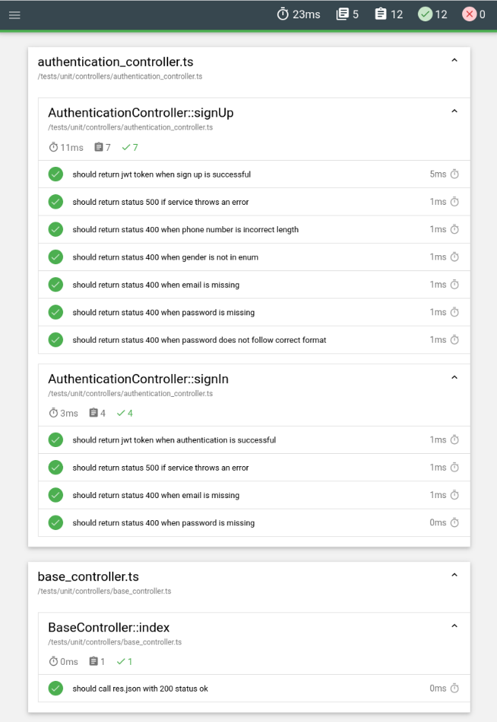
Unit test report

Slide 58
Code coverage with unit tests
We can generate code coverage reports for both the front end and server side using the appropriate libraries

Slide 59
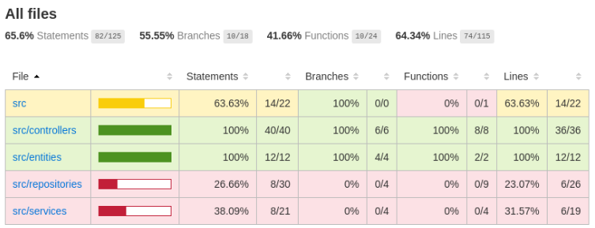
Code coverage report

Slide 60
Integration tests
Our integration tests are automated tests that run on our CI/CD pipeline
On pull requests
Anytime a pull requests is merged with the main branch
The server side tests use a full PostgreSQL DB instance running in docker
We have written db initialization and seeding scripts to help scaffold the tests
The client side tests use a mock API that returns stubbed responses

Slide 61
System Tests
Run manually
Can be automated but not on our roadmap
Tests the systems functionalities end-to-end
Format is steps / action for the tester to perform and the associated outcome for each

Slide 62
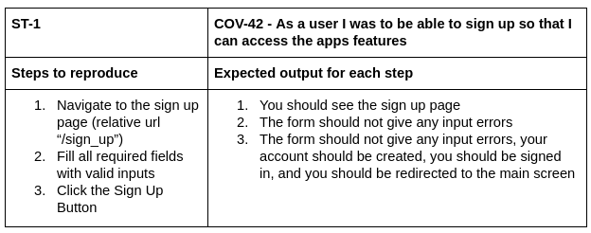

Slide 63
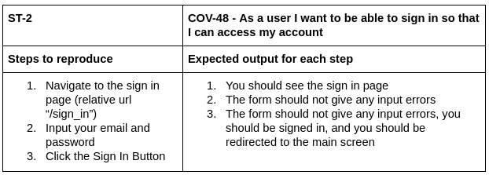

Slide 64
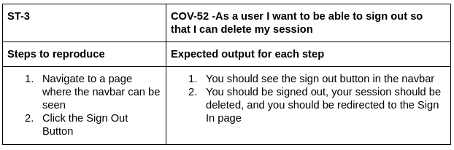

Slide 65
Acceptance Tests
Run manually
Can be automated but not on our roadmap
Tests the system according to the requirements
For use this means they are derived directly from our user stories
Format is Gherkin Syntax which is a behavioral driven development (BDD) syntax that allows us to define our tests in terms of user state and behavior

Slide 66
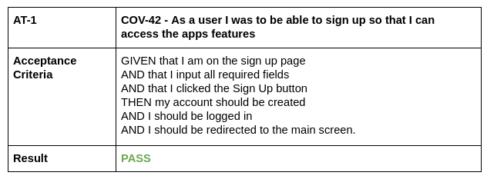

Slide 67
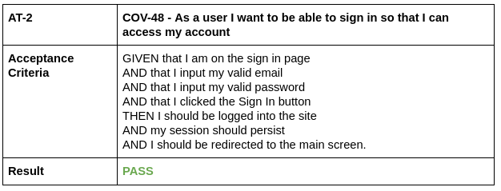

Slide 68
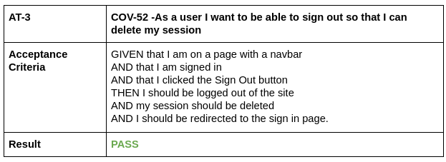

Slide 69
Live demo

Slide 70
Sprint 2 plan

Slide 71
What’s next in sprint 2?
Our focus will be on delivering
user stories in the
Authentication and authorization epic
Patient Management epic
Status management epic
Fix a few UI bugs
Finish up remaining front end infrastructure work
Sprint 2 contains 75 story points, which is ~33% increase from sprint 1
One of our main goals for this sprint is to have more frequent meetings, mainly refinement meetings so everyone in the team has ownership and visibility of the user stories

Slide 72
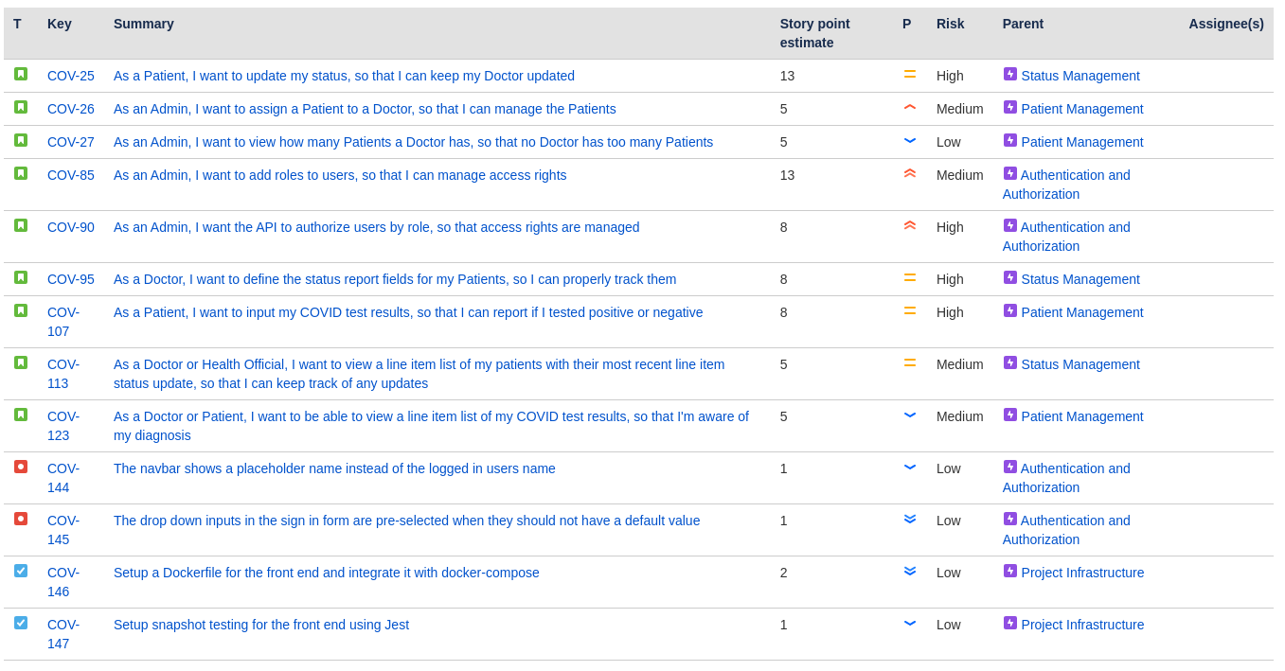

Slide 73
Questions?

